Slide 1
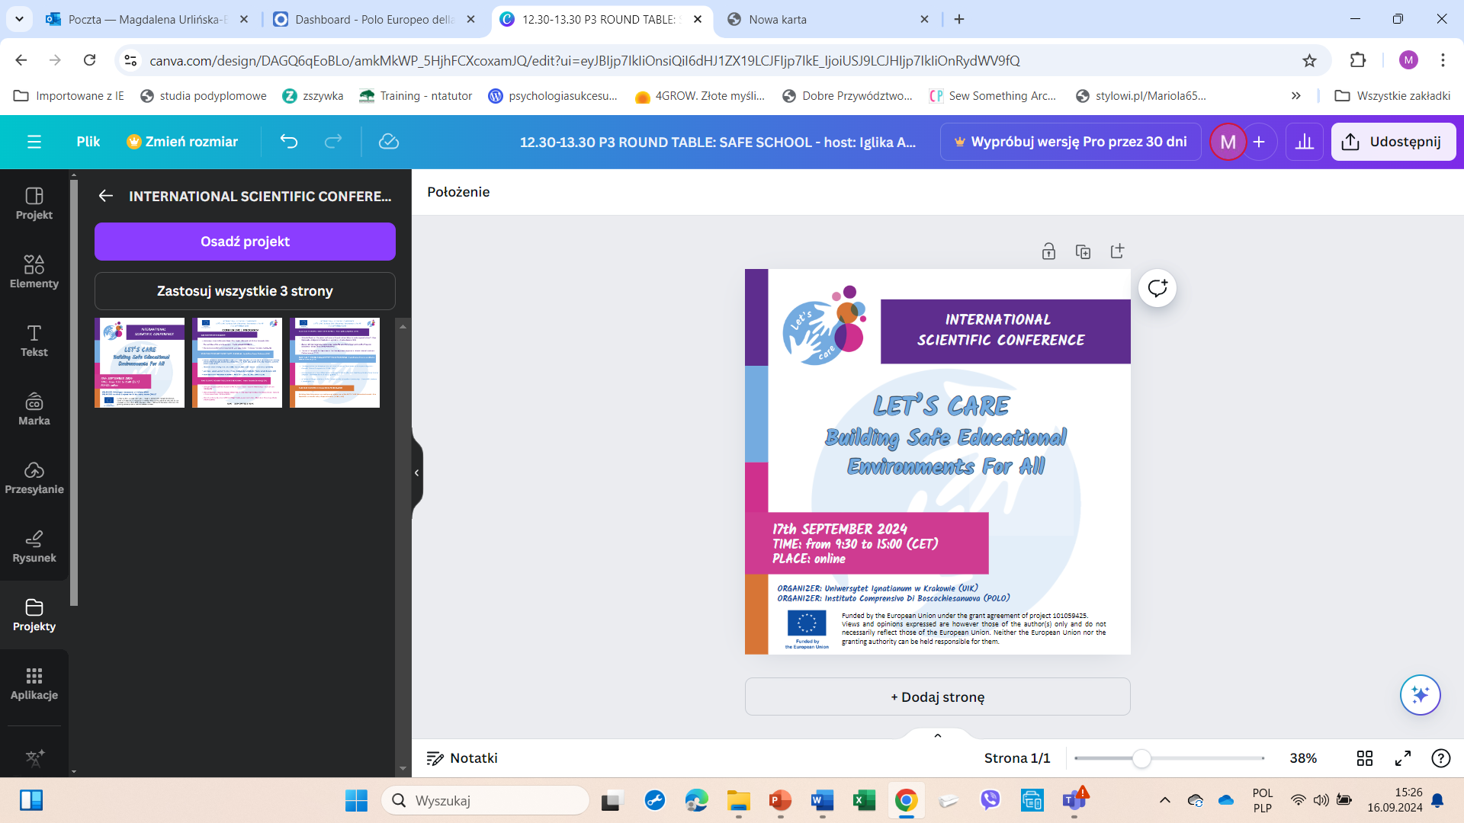


SAFE TEACHING TRAINING PROGRAMME
Topic 1.2.2
Resilience in the school space
This project has received founding form the European Union’s Horizon Europe research and innovation programme under grant agreement No. 101059425. Views and opinions expressed are however those of the author(s) only and do not necessarily reflect those of the European Union. Neither the European Union nor the granting authority can be held responsible for them.

Slide 2

Rezyliencja
Resilience is the ability to withstand and rebound from disruptive life challenges. It involves dynamic processes fostering positive adaptation within the context of significant adversity (Bonanno, 2004; Luthar, 2006; Masten, 2001; Walsh 2012)
Notes:
In the social sciences, the term resilience is a metaphor for the processes that make up the phenomenon of normal human existence and development despite objectively unfavourable conditions for living and developing. Poverty, stress, traumatic events and other unfavourable external conditions are the equivalents of ‘external forces’, while the adaptive processes in which humans mobilise internal and external resources correspond to ‘resilience forces’. Resilience is thus a metaphor for the time-varying processes of balancing or neutralising adverse life conditions through the internal and external resources available to humans (Ostaszewski, 2014, p. 74). In a reality dominated by variability, uncertainty, complexity and ambiguity, the attentiveness in pedagogy to the resilience resource and its use on educational grounds appears as an important need. Resilience appears to support learning and teaching, education, by supporting the processes of self-understanding/(self-)education/self-creation and self-determination and self-regulation, as well as clarifying complex reality. Resilience, therefore, is a kind of resilience and the art of living in the midst of challenges. An important component of resilience is subjectivity, which allows a person to orient and autonomic function in a fluid reality.

Slide 3
Resilience
RESILIENCE
challenges
adversities
too much stress
factors, processes or mechanisms that protect against risk factors
positive adaptation
Notes:
Three essential elements are identified for understanding what resilience is. The first element is the presence of and exposure (exposure) to risk factors, processes and mechanisms e.g. such as challenges, adversity, excessive stress. These are factors that tend to interfere with or disrupt overall wellbeing and functioning. The second element is the operation of factors, processes or mechanisms that protect against risk factors. The third element is the positive outcome of the ‘interaction’ of these two opposing ‘forces’ (risk factors and protective factors), i.e. positive adaptation. Positive adaptation, which is understood as a return to well-being after rebounding from a difficult situation. These components of resilience are variously named according to the experiences and linguistic traditions of researchers and authors (Masten, 2018; Ostaszewski, 2014)

Slide 4
Protective factors related to teachers' work
Individual personal characteristics
strong internal motivation emotional intelligence high sense of self-efficacy positive self-esteem optimism ability to self-regulate
Own skills
proactive attitude ability to accept failure ability to learn and move on problem-solving skills ability to live under pressure
Characteristics of the work/life environment
social support positive external sources of support feeling bonded to extended family support networks satisfied cooperation with colleagues positive relationships within the family and with friends

Slide 5
Risk factors related to the work of the teacher (in the context of resilience)
Individual risk factors
being negative self-beliefs or confidence
Contextual risk factors
Unsupportive/disorganised leadership staff
difficulty asking for help
conflict between personal beliefs and practices being used
Meeting needs of disadvantaged students
Lack of resources/equipment
Heavy workload, lack of time, non-teaching activities
Difficult schools, courses or classes
Externally imposed regulations
Curriculum/classroom knowledge
Unsupportive/no mentor
Low salary/poor funding
Poor hiring practices; insecurity
Inability to manage the class

Slide 6
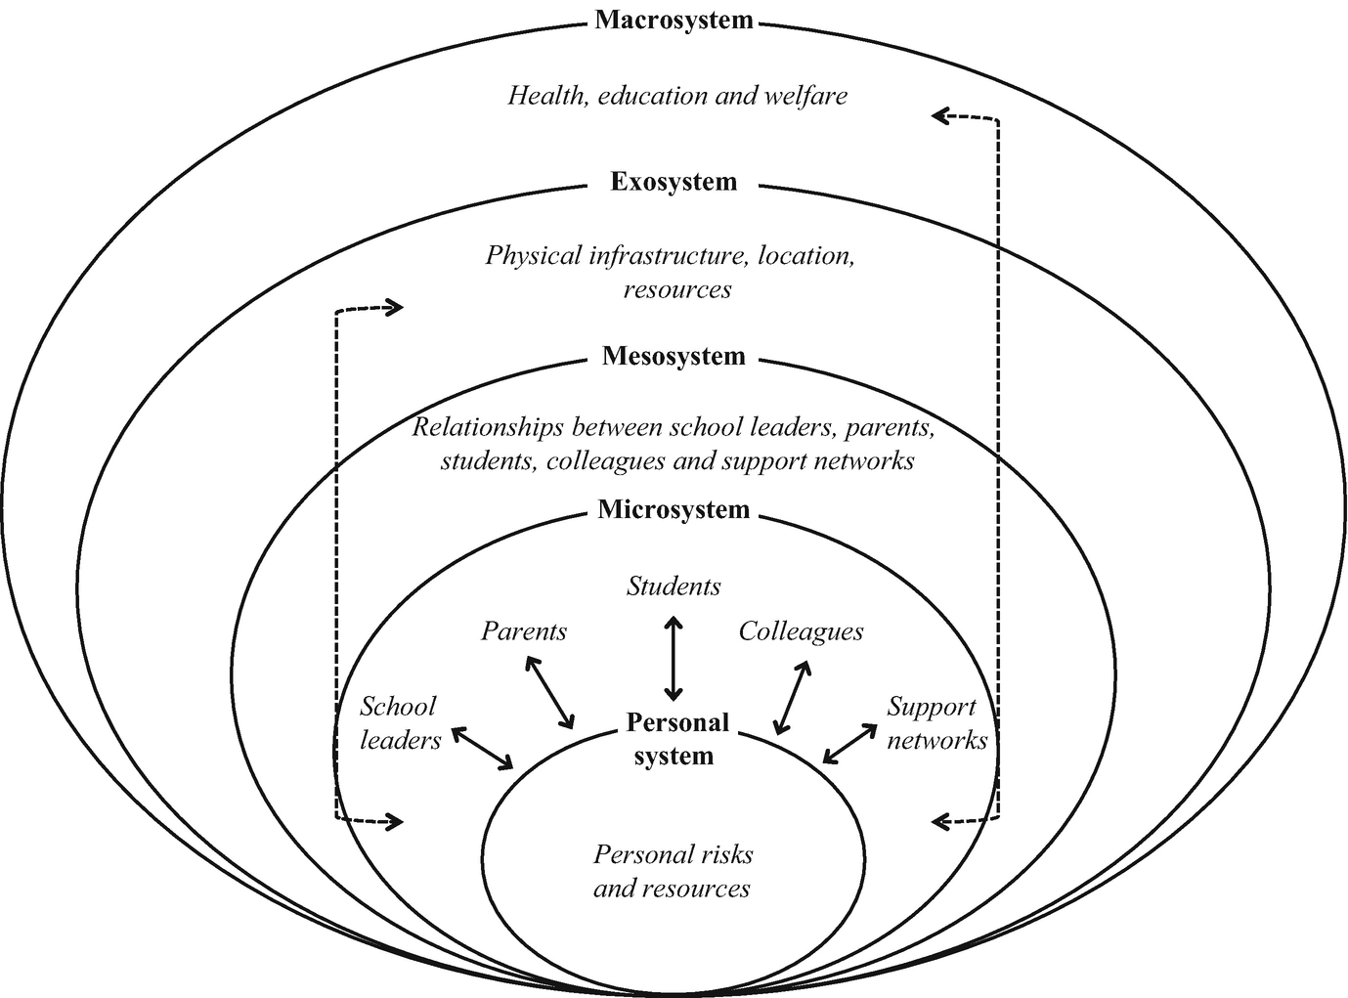
Teacher resilience
A systems approach to understanding teacher resilience (Adaptation of Bronfenbrenner Theory)
Source: Mansfield, C.F., Ebersöhn, L., Beltman, S., Loots, T. 2018
Notes:
The different contextual or systemic levels of risks and resources interact with each other to shape resilience in what is known to be a complex, dynamic, process
Different contextual or systemic levels of risk factors and protective factors work in interaction to shape resilience in a complex, dynamic process. Resilience is not an individual characteristic, but more a dynamic process that takes place between the individual and a constantly changing context. Therefore, it is useful to consider resilience from the perspective of the ecological model of the social environments in which a person lives.
Personal system risks and resources is difficulty in asking for help, low levels of confidenceor efficacy (Day 2008), conflicts between personal ideologies and current practices and family pressures.
Micro- and mesosystems comprise various groups of people such as students,school leaders and colleagues and the relationships between these and individualteachers. Teachers draw on resources at these levels to manage risks and help navigate through challenges.
Classroom or school challenges include:
meeting needs of disadvantaged students
unsupportive leadership staff
lack of resources
relationships
scrutiny of peers, parents and the principal
Resources that support teacher resilience:
positive relationships with colleagues
positive relationships with mentors
positive relationships with school leaders
positive relationships with students
having personal and professional support networks such as family support and social networks
Exosystem and macrosystem factors that would impact on teacher resilience through producing risks as well as available resources:
physical infrastructure
characteristics of a location
resources
policies related to health
education
welfare
Related risks for teachers:
heavy workload
lack of time
difficult schools or classes
externally imposed regulations
low salary
poor funding

Slide 7
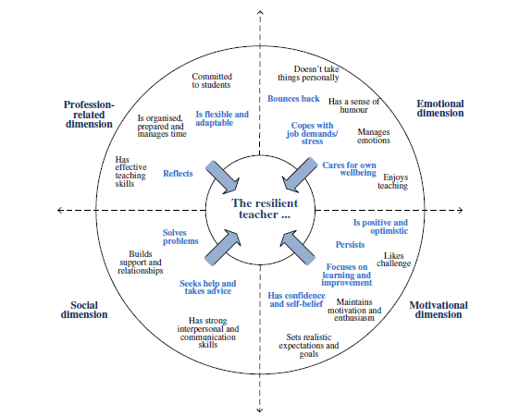
Resilient teacher
Source: Mansfield, C., Price, A., McConney, A., Beltman, S., Pelliccione, L., & Wosnitza, M. (2012). Keeping cool:
Embedding resilience in the initial teacher education curriculum. Australian Government. Office for
Learning and Teaching.
https://researchportal.murdoch.edu.au/esploro/outputs/report/Keeping-cool-Embedding-resilience-inthe/
991005545020907891
Document Version: Published (Version of Record)
Notes:
Dimensions that foster (or prevent) the development of teacher resilience:
Professional dimension (effective teaching strategies, reflectiveness, attachment to students)
Social dimension (support from school and family, seeking help, problem solving)
Emotional dimension (management of emotions, ability to bounce back after experiencing a highly stressful event, sense of humour)
Motivational dimension (perseverance, confidence, sense of purpose)

Slide 8
Education sensitive to resilience
‘Resilience-sensitive education’ (Riegger, 2018) = strengthening people and social systems through reflection and analysis of the content of life as a kind of response strategy, a holistic model of learning where they develop and are strengthened by this process, while taking into account some forms of risk.

Slide 9
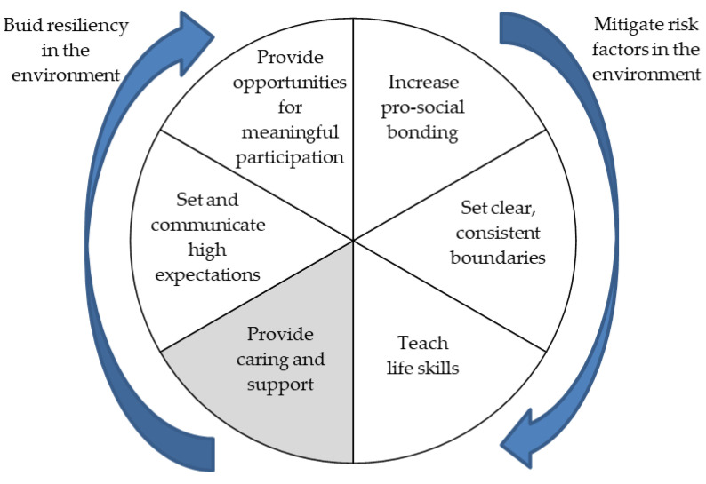
Resident child/resident student Resident teacher develops resilient student
Resiliency Wheel from the perspective of a child in school
Source: Henderson and Milstein (2005) cited in Moll Riquelme et al. (2022)
Notes:
It is the task of the educational environment to prepare the child to adopt socially approved competences in the area of resilience and to develop their own beliefs and skills for living in the context of stress and adversity.Premise: Human beings are capable of learning much more on their own than other living beings due to their instincts and their cognitive structures, but they cannot achieve the maximum of their abilities on their own if they do not receive support from educational/upbringing.

Slide 10
Teacher support for family resilience
Key Processes in Family Resilience /Wlash, 2012/
Belief systems
Make Meaning of Adversity
Transcendence and Spirituality
Organizational patterns
Flexibility
Social and Economic Resources
Communication
/problem solving
Clear, Consistent Messages
Collaborative Problem Solving
Positive Outlook
Connectedness
Open Emotional Expression
Notes:
Wiedza może być wykorzystana do kreowania odpowiednich relacji i współpracy między rodziną i szkoła

